Slide 1
MPI-ACC: Accelerator-Aware MPI for Scientific Applications
Authors: Ashwin M. Aji, Wu-chun Feng , Rajeev Thakur
Affiliate: Virginia Tech, Alamos National Laboratory, Argonne National Laboratory
Published in: IEEE Transactions on Parallel and Distributed Systems (TPDS’16 CCF A)
Presented by: Junpeng Zhu （朱君鹏）
Advisor: Yin Qian
Apr 3, 2019

Slide 2


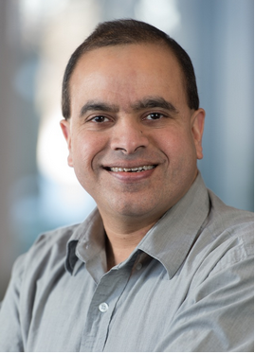
Authors
Now: Ph.D. Student
Education: Virginia Tech
Interests:
High Performance Computing
Emerging Parallel Architectures: for example, GPGPUs, APUs, etc.
Parallel Programming Models
Parallel Algorithms
Now: Professor
Education: Virginia Tech, Alamos National Laboratory
Interests:
High-performance networking Protocols
Dynamic multicore scheduling
Accelerator-based computing
Now: Deputy Director at Argonne National Laboratory
Educations: Syracuse University
Interests:
Operating systems
Architecture and security
High-performance and concurrent systems

Slide 3
OUTLINE
Introduction
Motivation & Example
MPI-ACC Design & Optimizations
Application Case Study
Experiments & Evaluation
Conclusions

Slide 4
Introduction
Graphics process units (GPUs) have widespread use as general-purpose computational processing units (GPUs) have gained accelerators and have been studied extensively across a broad range of scientific applications
15 percent of today’s top 500 fastest supercomputers (as of November 2014) employ general-purpose accelerators

Slide 5
Introduction
Hybrid programming with the Message Passing Interface (MPI) [5] and the Compute Unified Device Architecture (CUDA) [6] or Open Computing Language (OpenCL) [7] is the dominant means of utilizing GPU clusters
What is the significant performance impacts in the architecture of MPI+GPU?

Slide 6
OUTLINE
Introduction
Motivation & Example
MPI-ACC Design & Optimizations
Application Case Study
Experiments & Evaluation
Conclusions

Slide 7
Motivation & Example
Current GPU programmers must explicitly transfer data between the main memory and the device memory across PCIe
The current MPI standard assumes a CPU-centric single-memory model for communication.
Not handle GPU memory directly for the MPI programming

Slide 8
Motivation & Example
The default MPI+GPU programming model employs a hybrid two-staged data movement model, where data copies are performed between (1) main memory and the local GPU’s device memory that are preceded and/or followed by (2) MPI communication between the host CPUs
This is the norm seen in most GPU-accelerated MPI applications today
There is two aspects in theories and applications

Slide 9
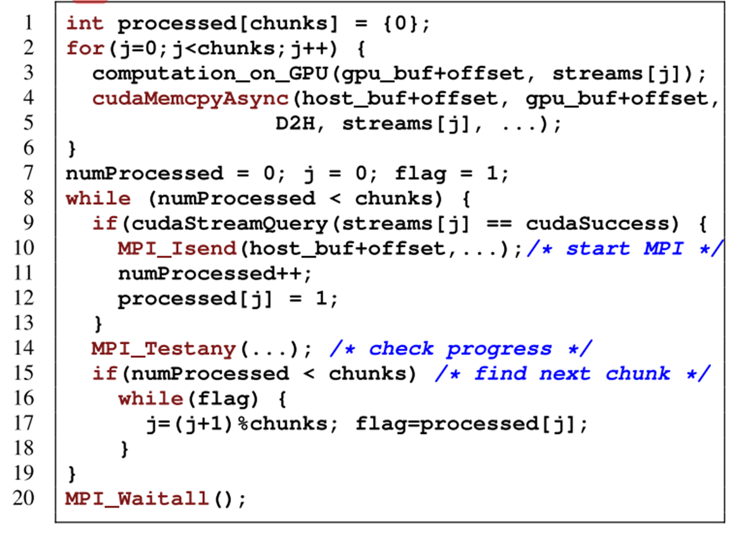
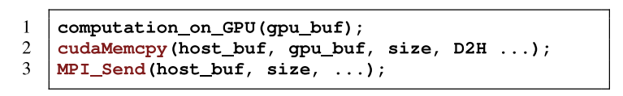
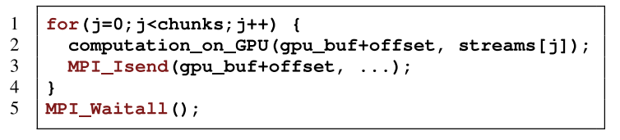
Motivation & Example

Slide 10
Motivation & Example
MPI-ACC provide a unified MPI data transmission interface for both host and GPU memories
The programmer can use either the CPU buffer or the GPU buffer directly as the communication parameter in MPI routines
The goal is to decouple the complex, low-level, GPU-specific data movement optimizations from the application logic
Enhancing programmability, transparent architecture-specific and vendor-specific performance optimizations can be provided within the MPI layer

Slide 11
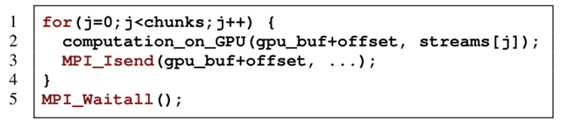
Motivation & Example
Using GPU-integrated MPI, programmers need only to write GPU kernels and regular host CPU codes for computation and invoke the standard MPI functions for CPU-GPU data communication, without worrying about the complex data movement optimizations of the diverse accelerator technologies.
Amazing Productivity!

Slide 12
OUTLINE
Introduction
Motivation & Example
MPI-ACC Design & Optimizations
Application Case Study
Experiments & Evaluation
Conclusions

Slide 13
MPI-ACC Design
Currently, In an MPI communication call, the user passes a void pointer that indicates the location of the data on which the user wishes to operate.
In other words, a pointer to host memory is indistinguishable from a pointer to GPU memory.
CUDA memory buffers are void pointers, but they cannot be dereferenced by the host unless Unified Virtual Addressing is enabled.
How to solve two issues?

Slide 14
MPI-ACC Design
MPI-ACC’s Datatype Attributes Approach
MPI datatypes are used to specify the type and layout of buffers passed to the MPI library
Once MPI-ACC has identified a device buffer, it leverages PCIe and network link parallelism to optimize the data transfer via pipelining

Slide 15
MPI-ACC Optimizations
Data Pipelining
The approach hides the PCIe latency between the CPU and GPU by dividing the data into smaller chunks and performing pipelined data transfers between the GPU, the CPU, and the network.
Invocation of MPI_Init and MPI_Finalize creates host-side buffer are registered with the GPU driver to orchestrate the pipelined data movement

Slide 16
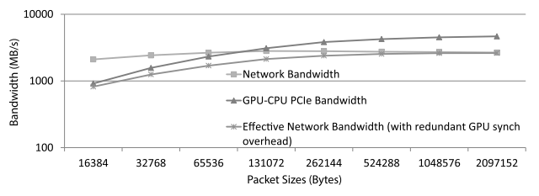
MPI-ACC Optimizations
Buffer Management
To calculate the ideal pipeline packet size

Slide 17
OUTLINE
Introduction
Motivation & Example
MPI-ACC Design & Optimizations
Application Case Study
Experiments & Evaluation
Conclusions

Slide 18
Application Case Study
Computational Epidemiology
The participating entities in GPU-EpiSimdemics are persons and locations
The output of the simulation is the relevant disease statistics of the contagion diffusion,
such as the total number of infected persons
an infection graph showing who infected whom and the time and location of the infection.

Slide 19
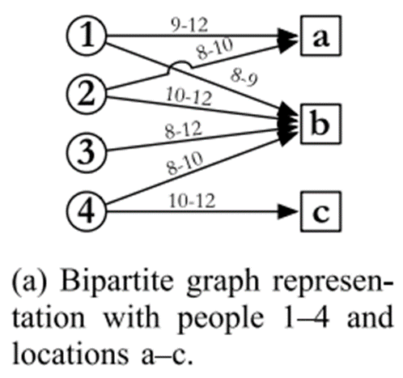
Application Case Study
GPU-EpiSimdemics consists of two phases：
computeVisits
all the person objects of every processing element (or PE) first determine the schedules for the current day, namely, the locations to be visited and the duration of each visit.
These visit messages are sent to the destination location’s host PE

Slide 20
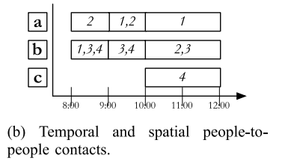
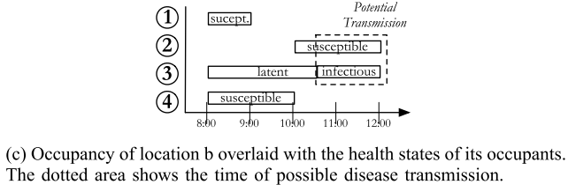
Application Case Study
GPU-EpiSimdemics consists of two phases：
computeInteractions
Each PE first groups the received visit messages by their target locations.
Next, each PE computes the probability of infection transmission between every pair of spatially and temporally collocated people in its local location objects
The infection transmission function depends on the current health states

Slide 21
Application Case Study
MPI-ACC–enabled communication-computation
MPI-ACC handles both CPU and GPU buffers, in each PE we preallocate persistent buffer fragments on the GPU and register them with the MPI library by using MPI_Recv_init.
GPU as MPI communication endpoints
The approach does not require a growing pinned memory pool on the host
Creating the end-to-end communication-computation pipeline

Slide 22
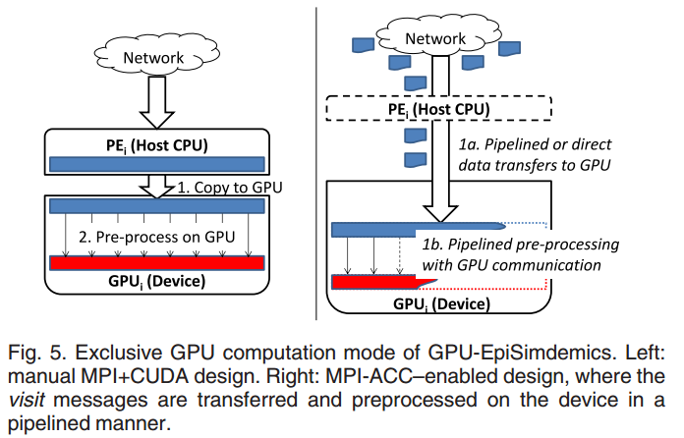
Application Case Study

Slide 23
OUTLINE
Introduction
Motivation & Example
MPI-ACC Design & Optimizations
Application Case Study
Experiments & Evaluation
Conclusions

Slide 24
Experiments & Evaluation
Experiments Environments
HokieSpeed, a state-ofthe-art, 212-teraflop hybrid CPU-GPU supercomputer housed at Virginia Tech
Each HokieSpeed node contains two hex-core Intel Xeon E5645 CPUs running at 2.40 GHz and two NVIDIA Tesla M2050 GPUs, all count 128 HokieSpeed nodes
host memory capacity is 24 GB, and each GPU has a 3 GB device memory
CUDA v5.0 and driver version 310.19 on latency microbenchmarks

Slide 25
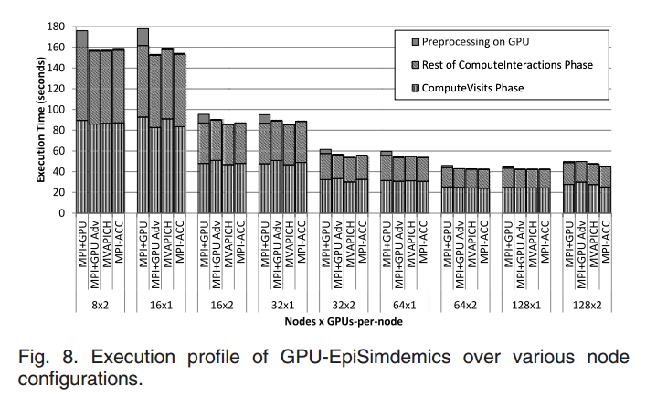
Experiments & Evaluation

Slide 26
Experiments & Evaluation
The basic MPI+GPU solution has preprocessing overhead but does not have significant memory management issues.
The advanced MPI+GPU implementation gains from hiding the preprocessing overhead, it loses from either nonscalable pinned memory management or poor programmer productivity.

Slide 27
Experiments & Evaluation
MPI-ACC provides a more scalable solution by (1) automatically managing a fixed-size pinned buffer pool for pipelining and (2) creating buffer pools just once at MPI_Init and destroying them at MPI_Finalize.
MPI-ACC thus gains from both hiding the preprocessing overhead and efficient pinned memory management.

Slide 28
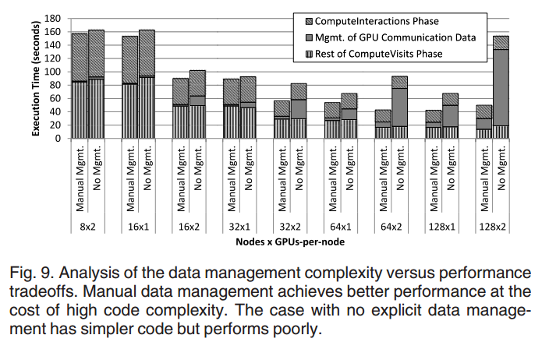
Experiments & Evaluation

Slide 29
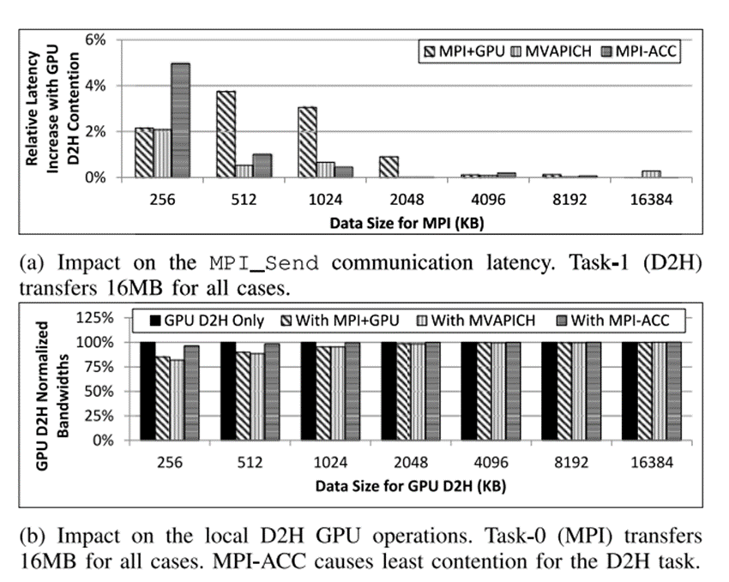
Experiments & Evaluation
The larger data size, the little increase relative latency.
The bandwidth is most largest among the four methods

Slide 30
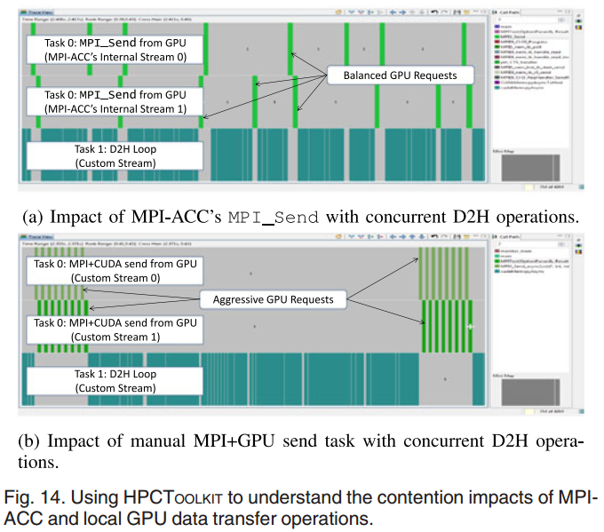
Experiments & Evaluation

Slide 31
OUTLINE
Introduction
Motivation & Example
MPI-ACC Design & Optimizations
Application Case Study
Experiments & Evaluation
Conclusions

Slide 32
Conclusions
We introduced MPI-ACC, an integrated and extensible framework that allows end-to-end data movement in accelerator-connected systems.
We discussed MPI-ACC’s API design choices and a comprehensive set of optimizations including data pipelining and buffer management.
MPI-ACC naturally express the communication target without explicitly treating the CPUs as communication relays.

Slide 33
Thanks & Comments!

